Slide 1

Water Quality Prediction
Drinking Quality Water is essential for health and well-being.
Water performs several vital functions in the human body, and consuming poor quality water can lead to serious health problems.
Water Quality depends mainly on the concentration of a certain group of elements in it like Aluminium, Fluoride, Chloride, Nitrates, Silver, etc.
Developed a Machine Learning model trained on 8000 samples of water with 20 features. (i.e. Concentration of elements)

Slide 2
Permissible limits
Aluminium < 2.8 mg/L
Ammonia < 32.5 mg/L
Arsenic < 0.01 mg/L
Barium < 2 mg/L
Cadmium < 0.005 mg/L
Chloramine < 4 mg/L
Chromium < 0.1 mg/L
Copper < 1.3 mg/L
Fluoride < 1.5 mg/L
Bacteria < 0 CFU/mL

Slide 3
Permissible limits
Viruses < 0 PFU/mL
Lead < 0.015 mg/L
Nitrates < 10 mg/L
Nitrites < 1 mg/L
Mercury < 0.002 mg/L
Perchlorate < 56 mg/L
Radium < 5 pCi/L
Selenium < 0.5 mg/L
Silver < 0.1 mg/L
Uranium < 0.3 mg/L

Slide 4
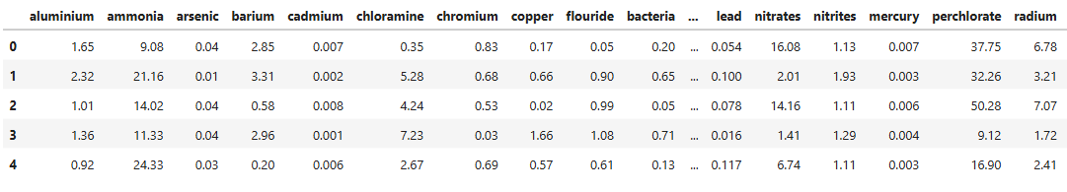
Dataset

Slide 5
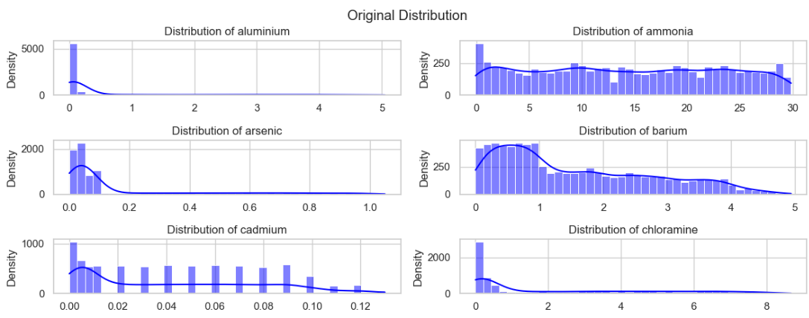
Distribution of Concentration of various elements

Slide 6
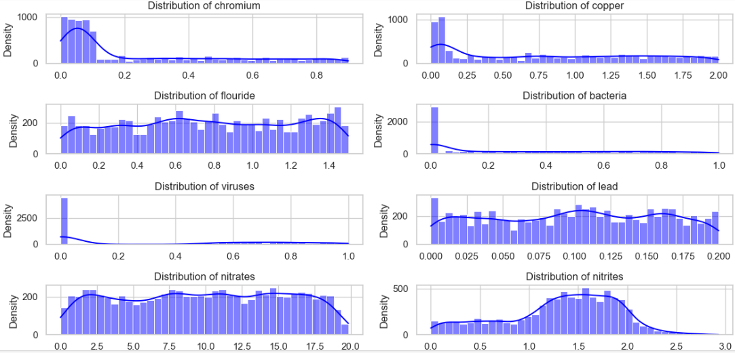

Slide 7
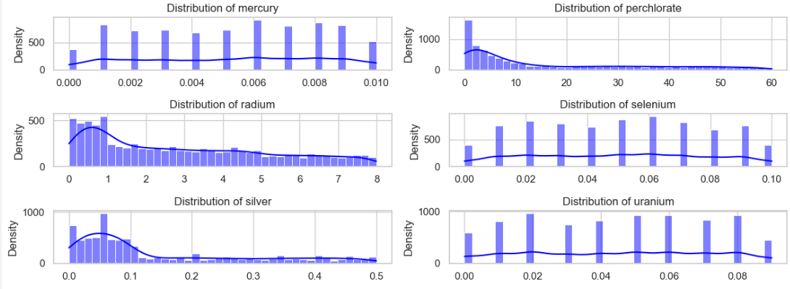
Distribution of Concentration of various elements

Slide 8
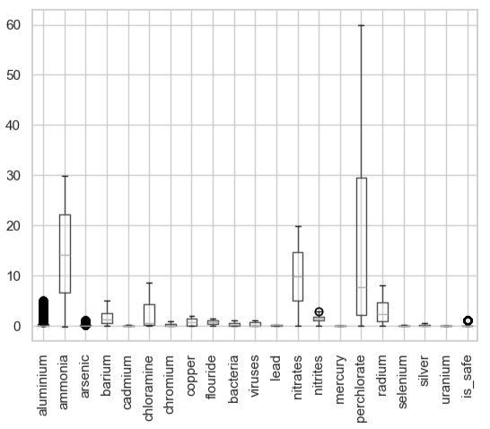
Box Plot

Slide 9
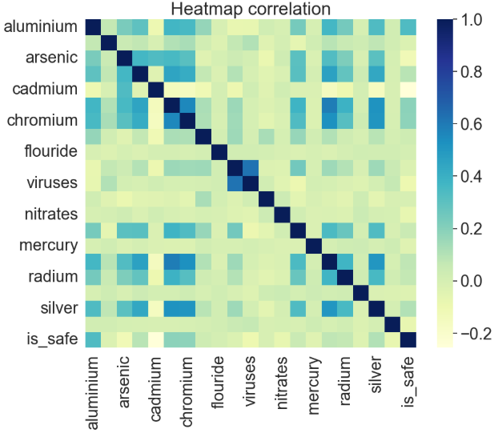
Heatmap Correlation

Slide 10
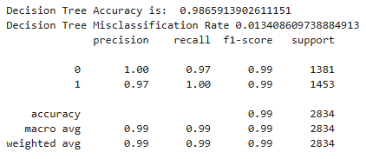
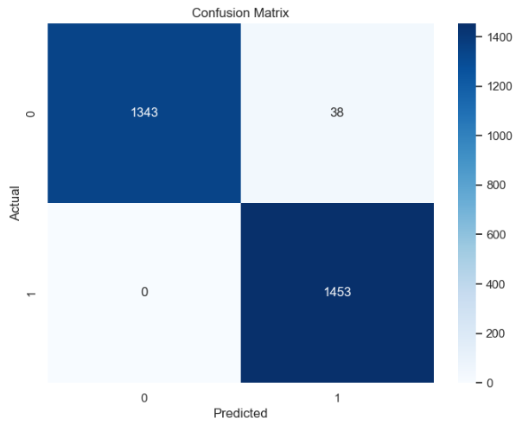
Decision Tree Classifier
Testing Accuracy : 98.66 %

Slide 11
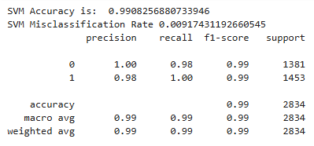
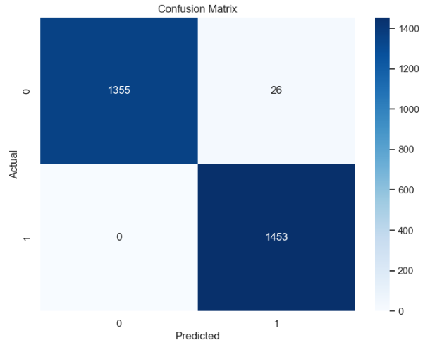
Support Vector Classifier
Testing Accuracy : 99.08 %

Slide 12
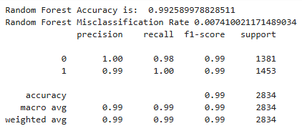
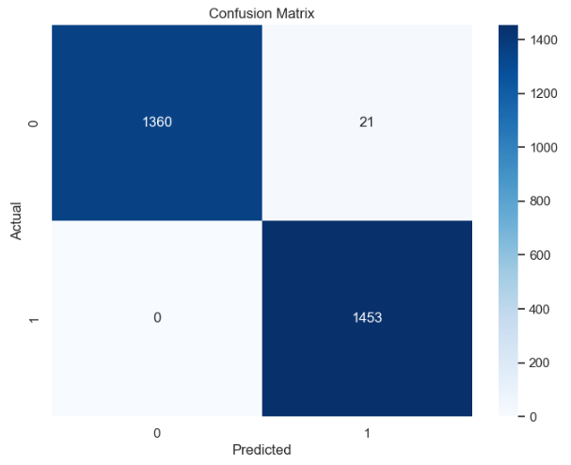
Random Forest Classifier
Testing Accuracy : 99.26 %

